Slide 1
Identity Scenarios Proof Of Concepts
Architecture and Principles

Slide 2
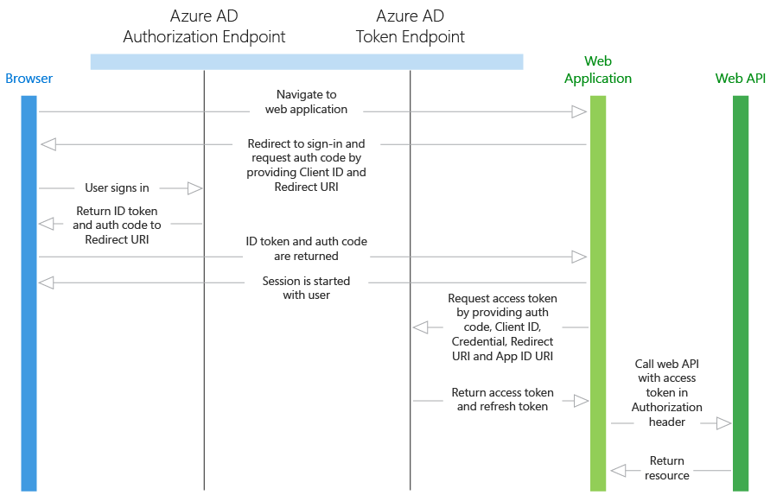
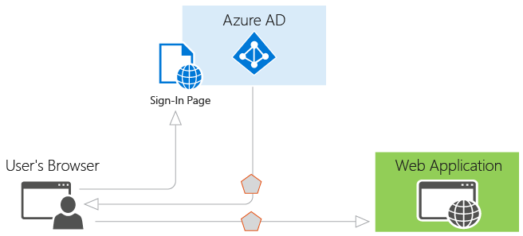
NBME Key Identity Management Scenarios
Web Application
Or
❶ User Single Sign On (SSO)
User Signs in to an Application using a Web Browser
➋ Application to Application Authentication
User Signs in to a Web Application using a Web Browser.
Web Application authenticates and works with an API OR another Web Application

Slide 3



NBME employee logs in to Webfred / Admin portal (resetting exams etc)
Process flow
STEP | EVENT
0 | Blank Azure Subscription
Webfred Admin Portal
Login
AD Azure Extension
1 | SiteAdmin Deploys Application along with all dependent components
NBME Employee
2 | Demo : User experience Azure AD extension intercepts the HTTP request and prompts for authentication
Azure AD
Registered App
aka ServicePrincipal
Azure AD
Documentation Reference: https://docs.microsoft.com/en-us/azure/app-service/app-service-mobile-how-to-configure-active-directory-authentication

Slide 4

Application to Application Authentication
Process flow
Student Portal
Request access for
Student AD App
+ Target WebFred AppID
STEP | EVENT
0 | Blank Azure Subscription
Login
or
1 | SiteAdmin Deploys Application along with all dependent components
Authorization Token
Student
Authorization
Token
(OAuth Bearer/ JWT)
Azure AD
D1 | DEMO Step 1: Student logs in to the Student Portal
D2 | DEMO Step 2: Student Portal Requests Authentication token for Student AD Application requesting access to WebFred
WebFred Portal
D3 | DEMO Step 3: Passes the token to WebFred along with other payload information
Student Azure AD
Registered App
aka ServicePrincipal
D4 | DEMO Step 4: WebFred validates the token and if successful continues processing the request
Documentation Reference: https://docs.microsoft.com/en-us/azure/active-directory/develop/active-directory-authentication-scenarios#daemon-or-server-application-to-web-api

Slide 5
Questions to ask…
Where is the master list of users stored? (On-prem AD, SalesForce, AAD)
Does the application need to know about users?
What does the applications need to Authenticate?
How do you operate/manage the users and the applications?

Slide 6

Student logs in
Current
Scenario
Azure AD
Student Portal
Authenticates
To Oracle Identity Manager
➊
❷
Azure AD
App Registration
Student
Authentication
Token
(OAuth Bearer/ JWT)
WebFred

Slide 7
On-Premises NBME employee logs in
Current
Scenario
Azure AD and On-premises AD Domain controller are connected using Azure AD Connect ( refer details here Trust diagram)
➊
WebFred / any other NBME Application
❷
➎
NBME
Employee
➌
➍
Azure AD
Windows Server
Active Directory
NBME On-Premise AD

Slide 8
Student Logs in to SalesForce
Future
Scenario

AAD Application Authentication
Uses AAD Registered Application, Client ID and Secret
Microsoft Azure Active Directory
Student
Authorization
Token
(OAuth Bearer/ JWT)
WebFred / any other NBME Application

Slide 9
Authentication across Architecture Layers
Future
Scenario
WebFred / any other NBME Application
Front End
Authorizes based on Authorization Token and lets the request continue
User
AAD Application Authentication [Uses AAD Registered Application, Client ID and Secret]
[Optionally]
Sends Authorization Token for Middle Tier (registered as an AAD Integrated Application)
Microsoft Azure Active Directory
Middle Tier (Business Layer)
Looks up datastore connection string in secure store
(like Azure KeyVault)
Data store
Authorizes based on Authentication Token and lets the request continue

Slide 10
Application to Application Authentication (e.g. Daemon, Service, API etc)
Future
Scenario
Application 1
Get Access Token
(AD Application Authentication)
Azure AD
Access Token
(OAuth 2.0 Bearer/ JWT)
Application 2
Authorizes and continues processing

Slide 11
Internal Application to Internal Application Authentication (e.g. Daemon, Service, API etc)
Future
Scenario
Application 1
➊
❷
Azure AD
Authentication
Token
(OAuth Bearer/ JWT)
Application 2
Authorizes and continues processing

Slide 12
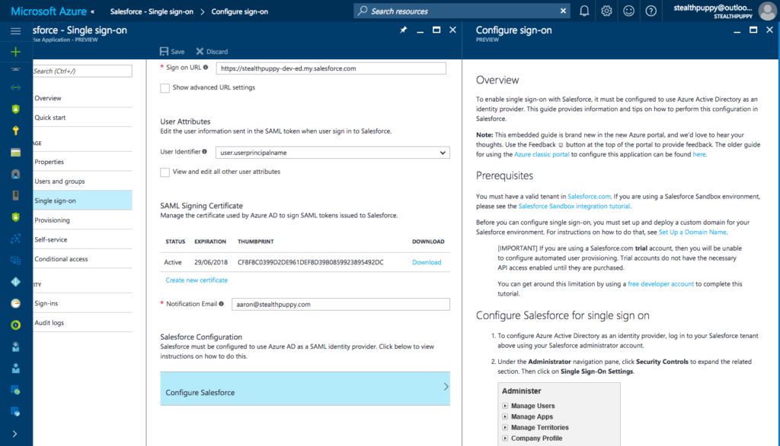
User SSO from External Application to Internal Application (e.g. SalesForce)
Future
Scenario
Microsoft Azure Active Directory
Register SalesForce as an Enterprise Application on Azure AD
Notes:
Notes:
Setting up SalesForce SSO - https://stealthpuppy.com/tips-enabling-sso-salesforce-azure-ad/#.WjuZlN-WZPY

Slide 13
Appendix

Slide 14









Cloud Identity Strategy Azure Active Directory as your central Authentication provider
Customers
Partners
Azure
Public
cloud
Windows Server
Active Directory
Microsoft Azure Active Directory
Cloud
BYO
On-premises

Slide 15
Cloud Identity Strategy Azure Active Directory as your central Authentication provider
Customers
Partners
Azure
Public
cloud
Windows Server
Active Directory
Microsoft Azure Active Directory
Cloud
BYO
On-premises

Slide 16
Azure AD
B IdP

